Slide 1

Evaluating the Performance of Object Detection Models for Accurate Sri Lankan Traffic Sign Detection
Learner Name: MN. Sihanas
Student Id: 1030371
Course & Batch: HND in Computing - 22
Assessor: Mrs. ALF. Sajeetha
Supervisor: Mrs. NF. Mafaza

Slide 2
Table of Contents
Introduction.
Aim of research.
Research question & Hypothesis. - IV,DV
Objective of research.
Literature Review.
Scope of research.
Top level architecture & WBS.
Methodology.
Limitations of research.
Timeline.
Cost & Benefit.
Conclusion.
Acknowledgement.
Table of Contents

Slide 3

Introduction.

Slide 4
Introduction
Importance of traffic sign detection in AI and computer vision.
Relevance to Sri Lankan road systems.
Comparing YOLOv8, Faster R-CNN, and SSD using mAP.

Slide 5
2. Aim of Research.

Slide 6
Aim
To compare the performance of YOLOv8, Faster R-CNN, and SSD for Sri Lankan traffic sign detection and identify the model with the highest mAP, contributing to improved automated traffic sign recognition and enhanced road safety in Sri Lanka using AI.

Slide 7
3. Research Question

Slide 8
Research Question
Research Question: Which object detection model (YOLOv8, Faster R-CNN, or SSD) achieves the highest accuracy in detecting Sri Lankan traffic signs, as measured by mean Average Precision (mAP)?
Dependent Variables: Mean Average Precision (mAP) (the accuracy of the models).
Independent Variable: The object detection model used (YOLOv8, Faster R-CNN, SSD).

Slide 9
4. Objective of Research

Slide 10
Objective & Sub objectives
Sub Objectives:
Review existing research on object detection models for traffic sign detection.
Understand the strengths and weaknesses of YOLOv8, Faster R-CNN, and SSD.

Slide 11
Objective
To conduct a comprehensive comparison of existing object detection models (YOLOv8, Faster R-CNN, and SSD) in terms of their suitability for Sri Lankan traffic sign detection.
To evaluate the performance of these models using the mean Average Precision (mAP) metric on a Sri Lankan traffic sign dataset.
To compare and analyze the results, identifying the most effective model for accurate traffic sign detection in Sri Lanka.

Slide 12
5. Scope of Research

Slide 13
Scope
Focus Area: Evaluating object detection models for Sri Lankan traffic sign detection.
Models Considered: YOLOv8, Faster R-CNN, and SSD.
Dataset: A dataset containing Sri Lankan traffic signs.
Evaluation Metric: Mean Average Precision (mAP) as the primary performance measure.

Slide 14
6.Limitations of Research

Slide 15
Limitations
The study focuses only on model evaluation, not implementation or fine-tuning.
Research is limited to Sri Lankan traffic signs and may not generalize to other regions.

Slide 16
7. Methodology

Slide 17
Methodology
Research Design: Quantitative research.
Data Collection Method: Secondary dataset (Sri Lankan traffic sign dataset).
Evaluation Approach: Analyze the performance of YOLOv8, Faster R-CNN, and SSD. Use mean Average Precision (mAP) as the key evaluation metric.
Comparison & Analysis: Compare the models based on mAP scores. Identify the most effective model for Sri Lankan traffic sign detection.

Slide 18
Literature Review

Slide 19
Title | Aim | Results | Methodology | Research Gap
Performance Comparison of Object Detection Models for Road Sign Detection Under Different Conditions – 2024 (Fatima, Z. T. M. M. H. V. R. R. T. a. R. R., 2024. Performance Comparison of Object Detection Models for Road Sign Detection Under Different Conditions. International Journal of Advanced Computer Science and Applications, 15(12).) | state-of-the-art object detection models (YOLOv8, YOLOv9, RTMDet, Faster R-CNN, RetinaNet) for road sign detection. | YOLOv9 and YOLOv8 performed best in real-time detection, while RTMDet provided a balance of speed and accuracy. Faster R-CNN and RetinaNet had better precision but were slower. | Models were fine-tuned and evaluated on a large dataset using mAP, FPS, and total loss as key metrics. Training involved data augmentation and hyperparameter tuning. | Focused on general road sign detection but did not evaluate models on region-specific datasets.
A Traffic-Sign Detection Algorithm Based on Improved Sparse R-CNN – 2017 (Jinghao Cao, J. Z. X. J., 2021. A Traffic-Sign Detection Algorithm Based on Improved Sparse R-cnn. IEEE Access.) | To enhance Sparse R-CNN for traffic sign detection using an improved backbone and attention mechanism. | Achieved improved mAP and robustness compared to traditional Sparse R-CNN. Res2Nest and improved DIIH enhanced detection, especially for small signs. | Proposed an improved ResNest-based backbone (Res2Nest) and Dynamic Instance Interactive Head (DIIH) for better multi-scale feature representation and accuracy. Evaluated using the TT100K dataset. | Needs optimization for lower computational cost while maintaining accuracy.
Evaluating and Benchmarking Object Detection Models for Traffic Sign Detection – 2022 (Mishra, A. K. A. M. S. A. K. Z. J. S. S. a. T. A., 2022. Evaluating and Bench-marking Object Detection Models for Traffic Sign and Traffic Light Datasets, s.l.: Computer Vision Foundation.) | To benchmark object detection models (Faster R-CNN, YOLOv3, SSD, RetinaNet, CenterNet, Cascade R-CNN) for traffic sign detection across multiple datasets. | CenterNet and Cascade R-CNN performed best overall, with CenterNet excelling in small object detection. Faster R-CNN and YOLOv3 provided competitive results in specific datasets. | Models were evaluated using precision, recall, and mean average precision (mAP) on different datasets, including TT100K and GTSD. | Existing models struggle under adverse weather and occlusions.

Slide 20
Timeline

Slide 21
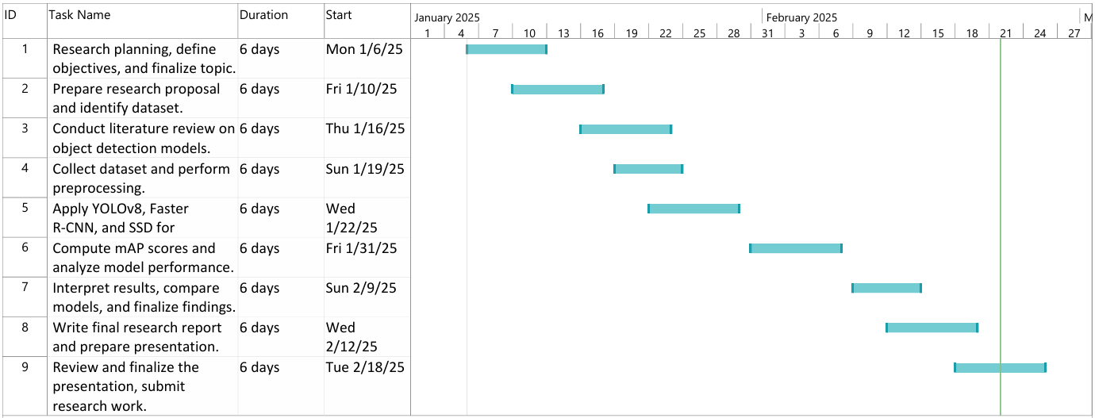

Slide 22
Cost & Benefits

Slide 23
Description | Cost
Power Consumption | 1,800 LKR
Computational resources | 4,000 LKR
Cloud services | 5,500 LKR
Infra Structure | 1,500 LKR
Manpower | 3,700 LKR
Total Cost | 16,500 LKR
Benefits:
Helps optimize model selection for real-world applications in Sri Lanka’s transportation sector.
Advances research in computer vision and AI for traffic management.

Slide 24
Top level architecture & WBS

Slide 25
Research Design
Literature Review
Research Planning & Proposal
Preliminary Study
Dataset (Sri Lankan Traffic Sign)
Preprocessing
Model Inference (YOLOv8, Faster R-CNN, SSD)
Best Model Selection
Comparison & Analysis
Evaluation (mAP)
Report & Documentation

Slide 26
Work Break Down Structure
Evaluating the Performance of Object Detection Models for Accurate Sri Lankan Traffic Sign Detection
1. Research Planning & Proposal
2. Literature Review
3. Data Collection & Preparation
4. Model Evaluation & Analysis
5. Results Interpretation & Documentation
6. Report Writing & Presentation
Define research problem & objectives.
Review related research on traffic sign detection.
Obtain the Sri Lankan traffic sign dataset.
Apply object detection models on the dataset.
Interpret evaluation results.
Write the final research report.
Prepare research proposal.
Study object detection techniques (YOLOv8, Faster R-CNN, SSD).
Perform data pre-processing
Compute mAP scores for each model.
Document findings and insights.
Prepare the presentation slides.
Identify dataset and object detection models.
Compare and analyze model performance.
Discuss implications for AI-based traffic systems.
Present findings and conclusions.
Analyze previous work on AI-based traffic systems.

Slide 27
WBS | Task Description
1 | Research Planning & Proposal
1.1 | Define research problem & objectives
1.2 | Prepare research proposal
1.3 | Identify dataset and object detection models
2 | Literature Review
2.1 | Review related research on traffic sign detection
2.2 | Study object detection techniques (YOLOv8, Faster R-CNN, SSD)
2.3 | Analyze previous work on AI-based traffic systems
3 | Data Collection & Preparation
3.1 | Obtain the Sri Lankan traffic sign dataset
3.2 | Perform data pre-processing
4 | Model Evaluation & Analysis
4.1 | Apply object detection models on the dataset
4.2 | Compute mAP scores for each model
4.3 | Compare and analyze model performance
5 | Results Interpretation & Documentation
5.1 | Interpret evaluation results
5.2 | Document findings and insights
5.3 | Discuss implications for AI-based traffic systems
6 | Report Writing & Presentation
6.1 | Write the final research report
6.2 | Prepare the presentation slides
6.3 | Present findings and conclusions

Slide 28
Conclusion

Slide 29
Conclusion
The study evaluates YOLOv8, Faster R-CNN, and SSD for Sri Lankan traffic sign detection.
mAP (mean Average Precision) is used to measure model performance.
The research identifies the most accurate model for Sri Lankan road conditions.
Findings contribute to AI-driven traffic systems and autonomous vehicles.
Helps improve road safety and smart transportation solutions in Sri Lanka.

Slide 30

Acknowledgement
Thanks To,
Supervisor: Mrs. NF. Mafaza.
Assessor: Mrs. ALF. Sajeetha.
Coordinator: Mr. MIM. Nismy.
BCAS Campus Kalmunai.

Slide 31

Questions?

Slide 32

Thank you

